Slide 1

Color Assistant

Slide 2
COLOR BLINDNESS
Notes:
Color blindness is a vision deficiency that inhibits the ability to distinguish between certain colors.
Cones vs. Rods:
- Rods only detect light vs dark
- Cones detect color
Cones:
- The different cones that detect color are red, blue, and green. (r, g, b)
- The three cones, S, M, and L, send messages to the brain which interpret millions of different colors
- (Blue) S-Cone: Responsive to short wavelength
- (Green) M-Cone: Responsive to medium wavelength
- (Red) L-Cone: Responsive to long wavelength
Types of colorblindness
- Monochromatism: The person only has one or zero set of cones
- Dichromatism: The person has two out of the three cone types while the third is completely missing
- Anomalous trichromatism: Has all three cones, however the responsiveness to colors are
---
- Tritanopia/Tritanomaly: Missing (Blue) S-Cone
- Deuteranopia/Deuteranomaly: Missing (Green) M-Cone
- Protanopia/Protanomaly: Missing (Red) L-Cone

Slide 3
Most cases of colorblindness occur at birth but you can develop color deficiency later in life

Slide 4
Estimated 250 million people in the world are colorblind

Slide 5
8% of men worldwide are colorblind while only .5% of women are

Slide 6
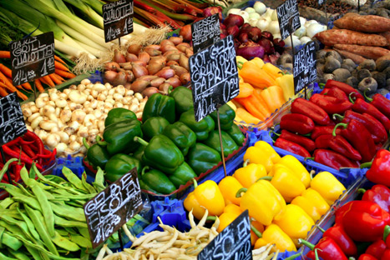
Normal Vision

Slide 7
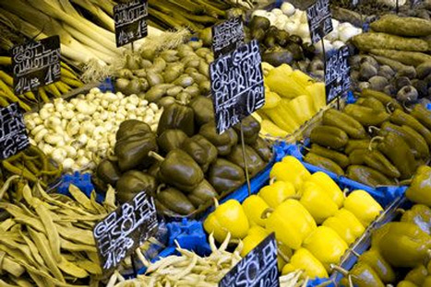
DEUTERANOPIA Missing (Green) M-Cone
Notes:
Deuteranopia/Deuteranomaly: Missing (Green) M-Cone

Slide 8
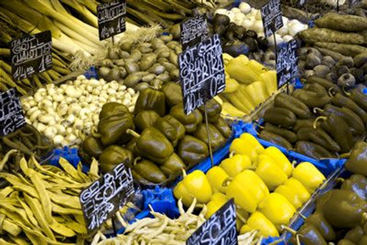
PROTANOPIA Missing (Red) L-Cone
Notes:
Protanopia/Protanomaly: Missing (Red) L-Cone

Slide 9
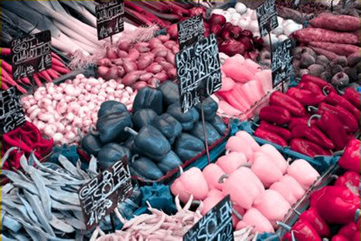
TRITANOPIA Missing (Blue) S-Cone
Notes:
Tritanopia/Tritanomaly: Missing (Blue) S-Cone

Slide 10
Product Vision
I would like to address the needs of the colorblind community by addressing these key areas:
Aid in the ability for a colorblind person to be able to distinguish between colors through color identification using the camera on a iPhone or iPad
Aid an individual being able to pick color items from their wardrobe and be assured that they have can identify the color that they are looking for

Slide 11
Product Vision
Notes:
We would like to address the needs of the colorblind community by addressing the following key areas

Slide 12
Distinguish Color using a mobile device
Notes:
Aid in the ability for a colorblind person to be able to distinguish between colors through color identification using the camera on a iPhone or iPad

Slide 13
Enhance or aid the user in coordinating their clothes
Notes:
Help a user choose their clothing. Allowing them to have a better insight on whether the clothes they are looking at are the color that they desire while also letting the user know if the colors are visually appealing together or match.

Slide 14
User Personas
The stigma fighter
The fashionista
The shopper
The worker
The artist
Notes:
We have 5 user personas

Slide 15

The Stigma Fighter
Notes:
The stigma fighter doesn't want to be embarrassed by others knowing about the color blindness.
Nobody understands the discomfort they feel when asked what color something is.

Slide 16

The Fashionista
Notes:
The fashionista wants to be able to match the clothes they pick to wear however, they are colorblind.
Sometimes they pick out great outfits to wear but then they go out and are made fun of because their outfit is not matched correctly.
A tool for matching and identifying colors will be very beneficial.

Slide 17

The Shopper
Notes:
The shopper wants to go shopping for clothes to wear but they like an article of clothing because they believe it is a certain color.
However, when they go and wear it they are told it is not the color they thought it was and they are embarrassed because that is not the color they thought it was.

Slide 18

The Professional
Notes:
The worker needs to be able to see the correct colors in order to complete their jobs or hobbies correctly.
It is important that the worker can submit work their work with certainty that it is done correctly and not only looks nice but is what their intended vision was.

Slide 19

The Artist
Notes:
The artist wants to create meaningful and impactful content to captivate their audience.
It can be hard for colorblind artists to differentiate between colors outside the realm of digital art.
An app that can bring a color dropper to real life situations can be a valuable tool for artists.

Slide 20
Feature Identification
Color Identification
Wardrobe Assistant

Slide 21
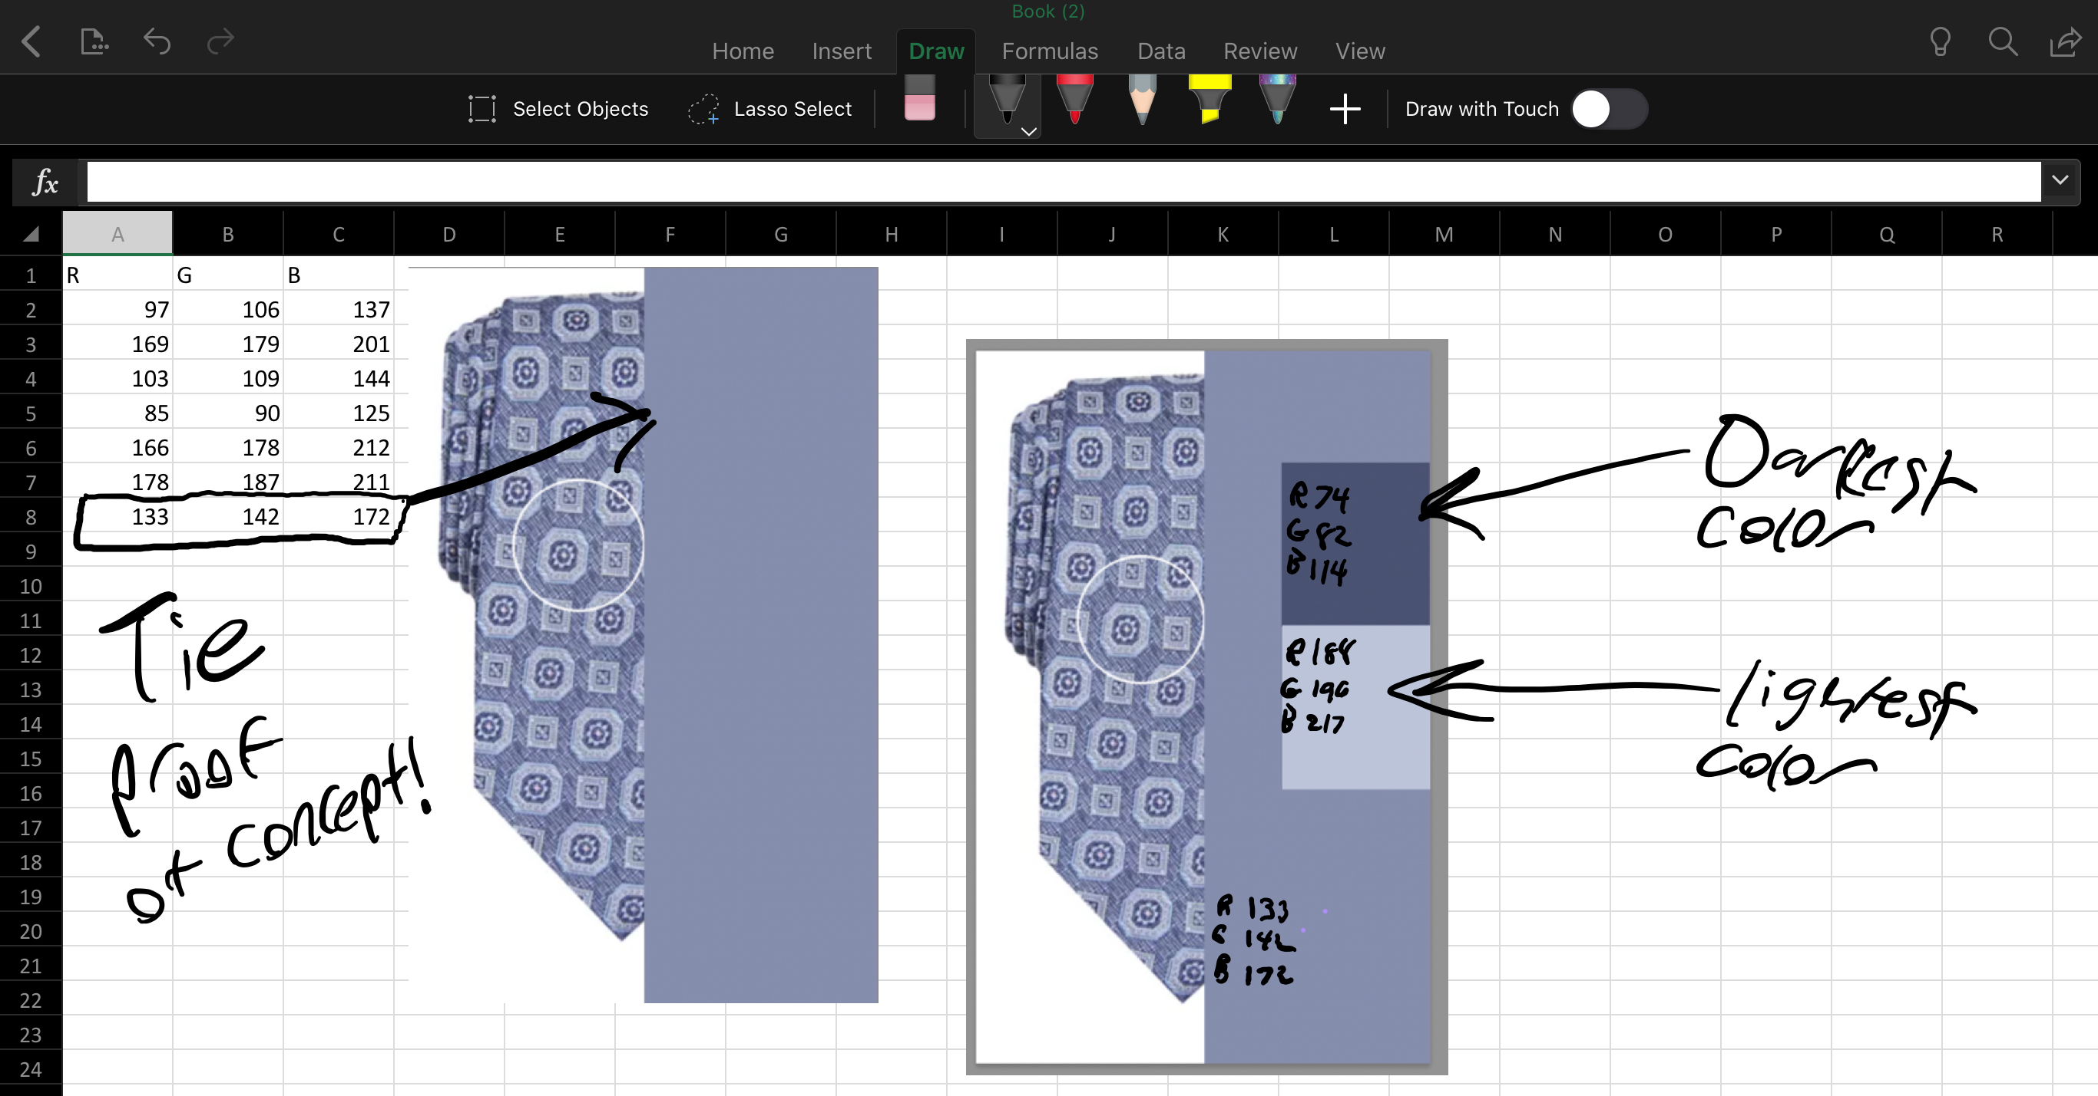
Color Identification
Color identification will allow a user to identify what color an object is.
The color assistant application will do so by taking the average RGB values of the object providing a close approximation of what the color is.

Slide 23
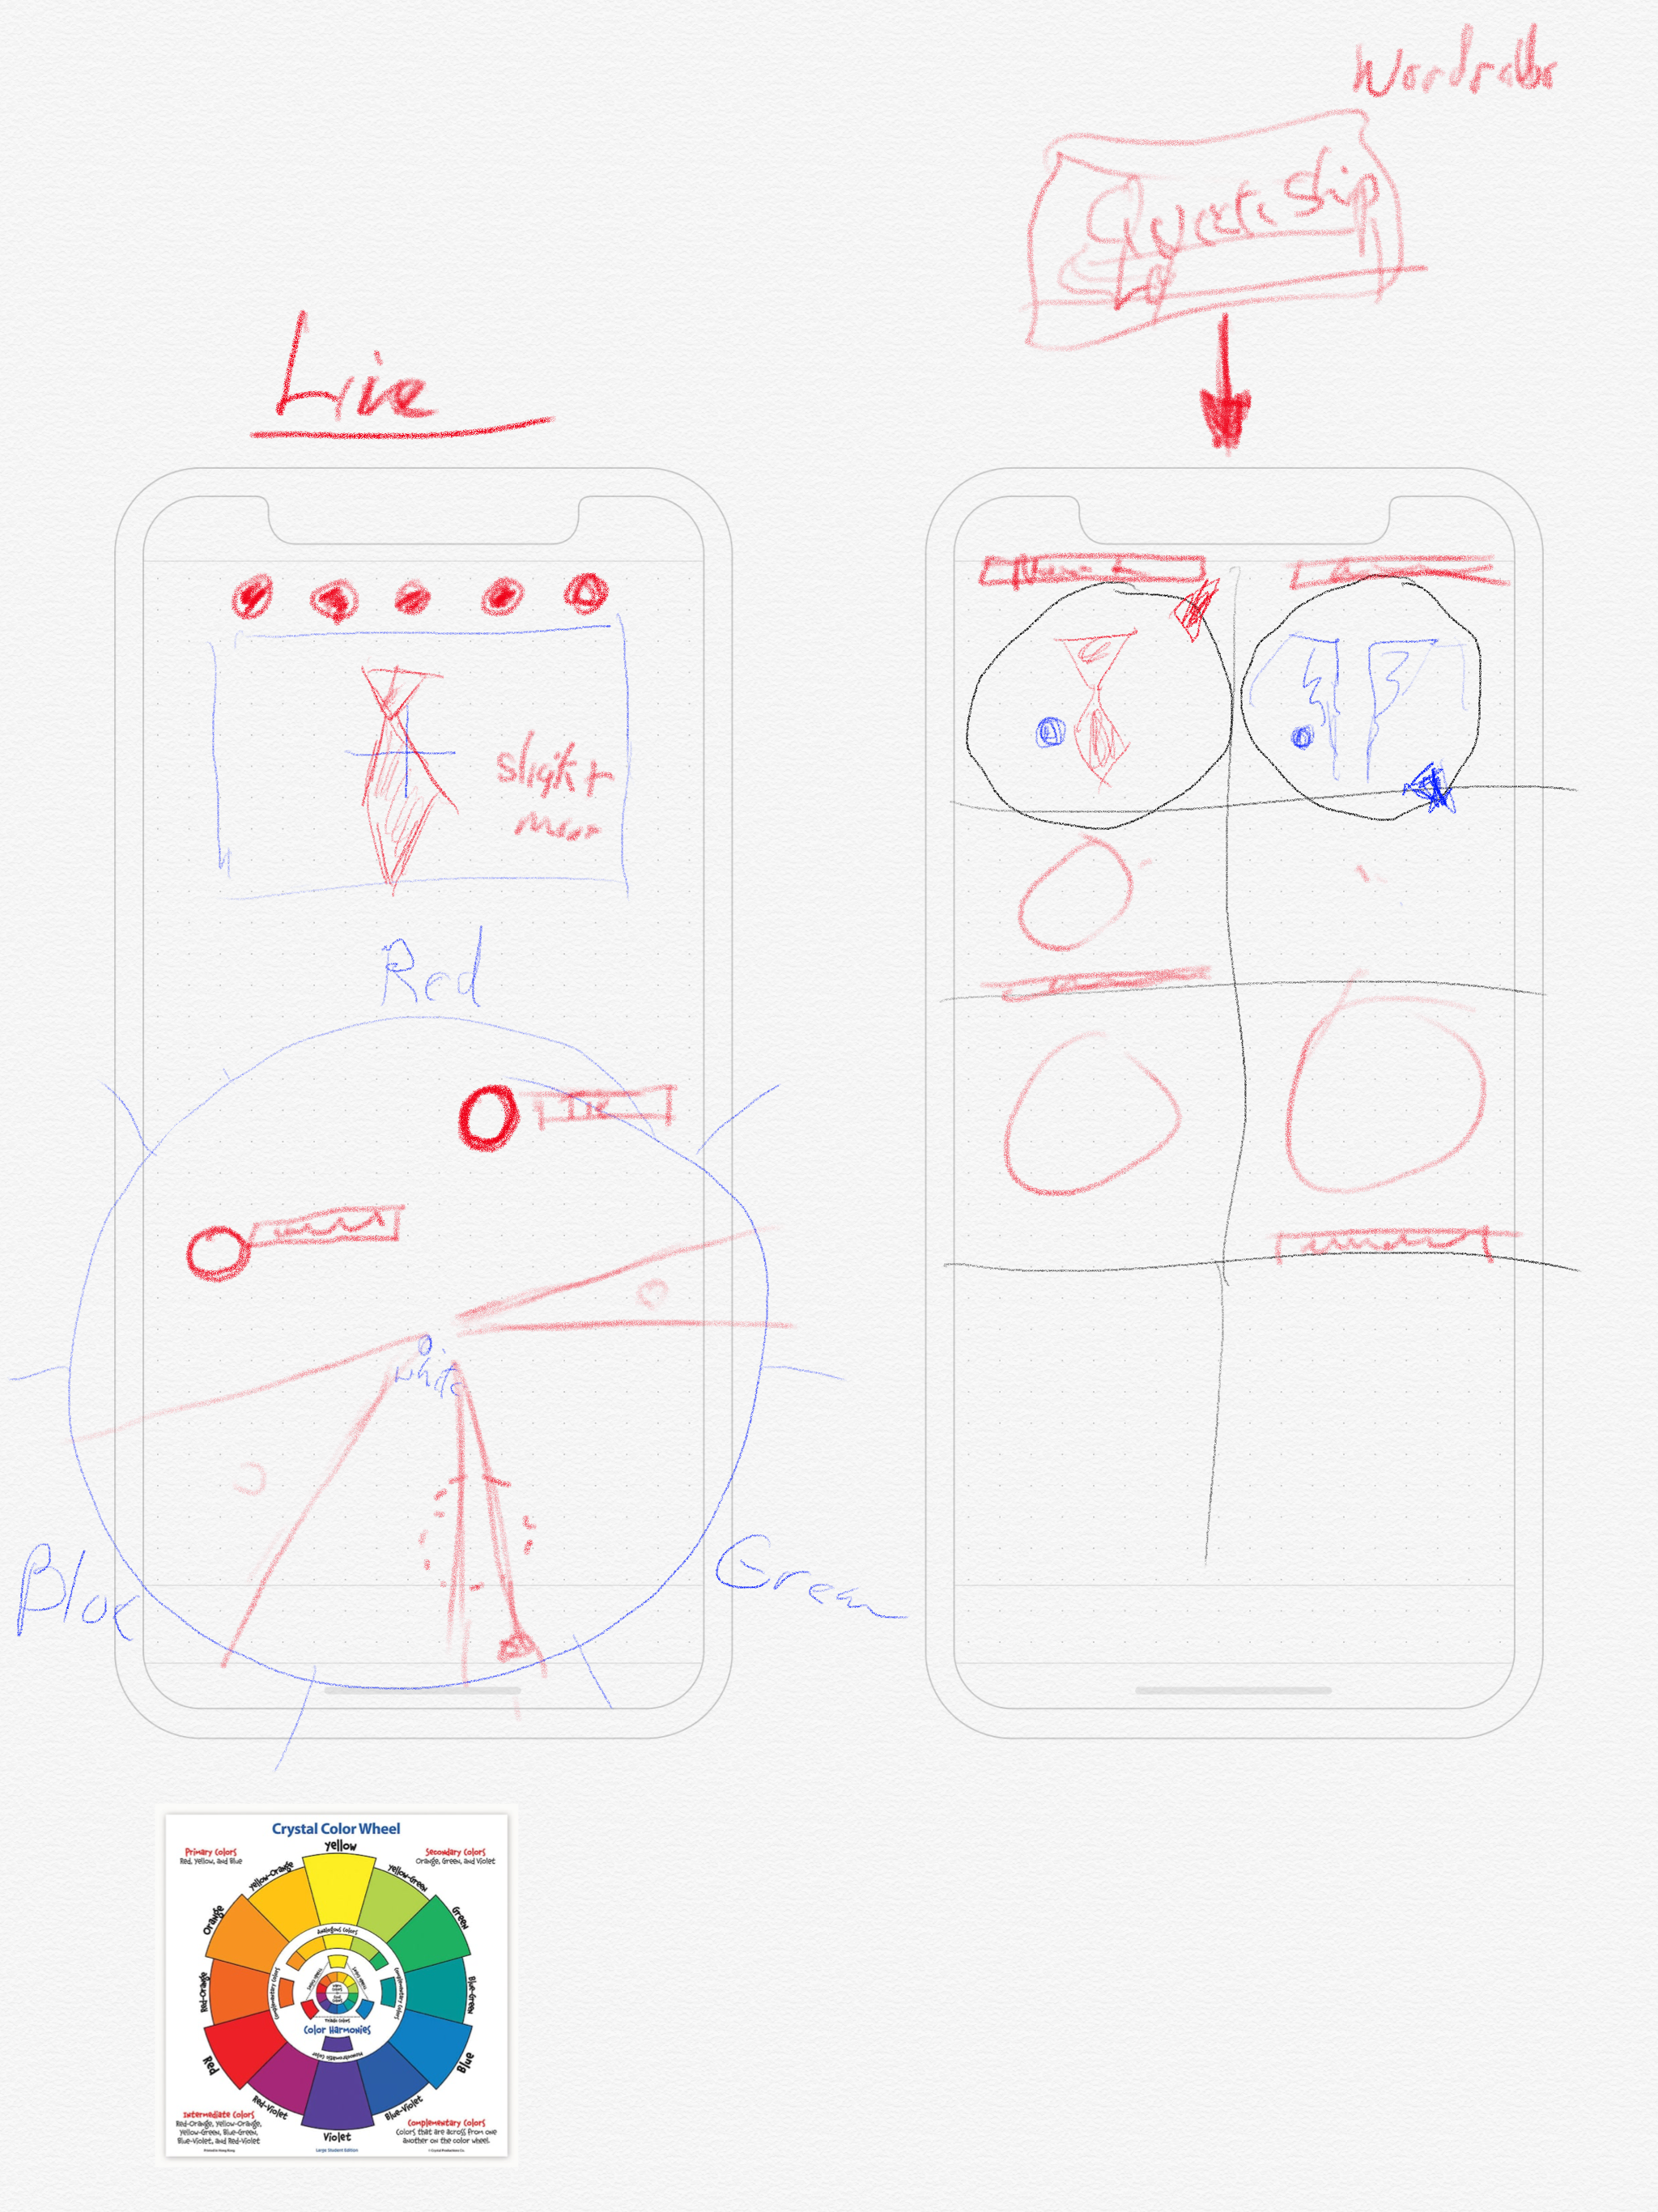
Wardrobe Assistant
Using Color detection, Wardrobe assistant will allow the user to pair articles of clothing that go together.

Slide 25
Demo

Slide 26
Swift code
Notes:
Switch to Playground

Slide 27
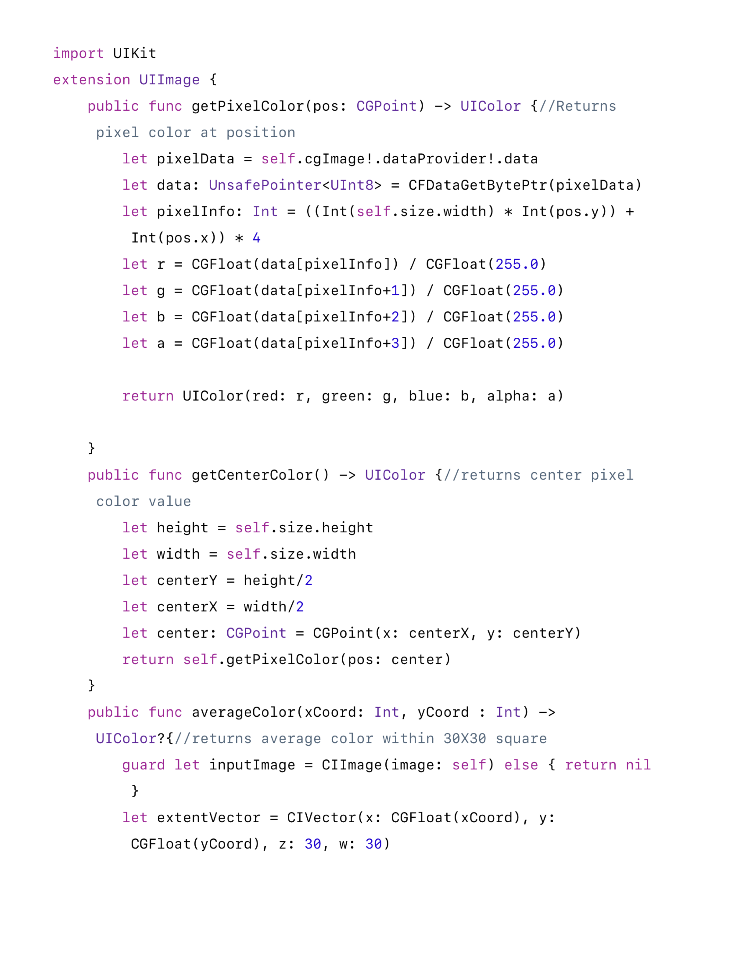
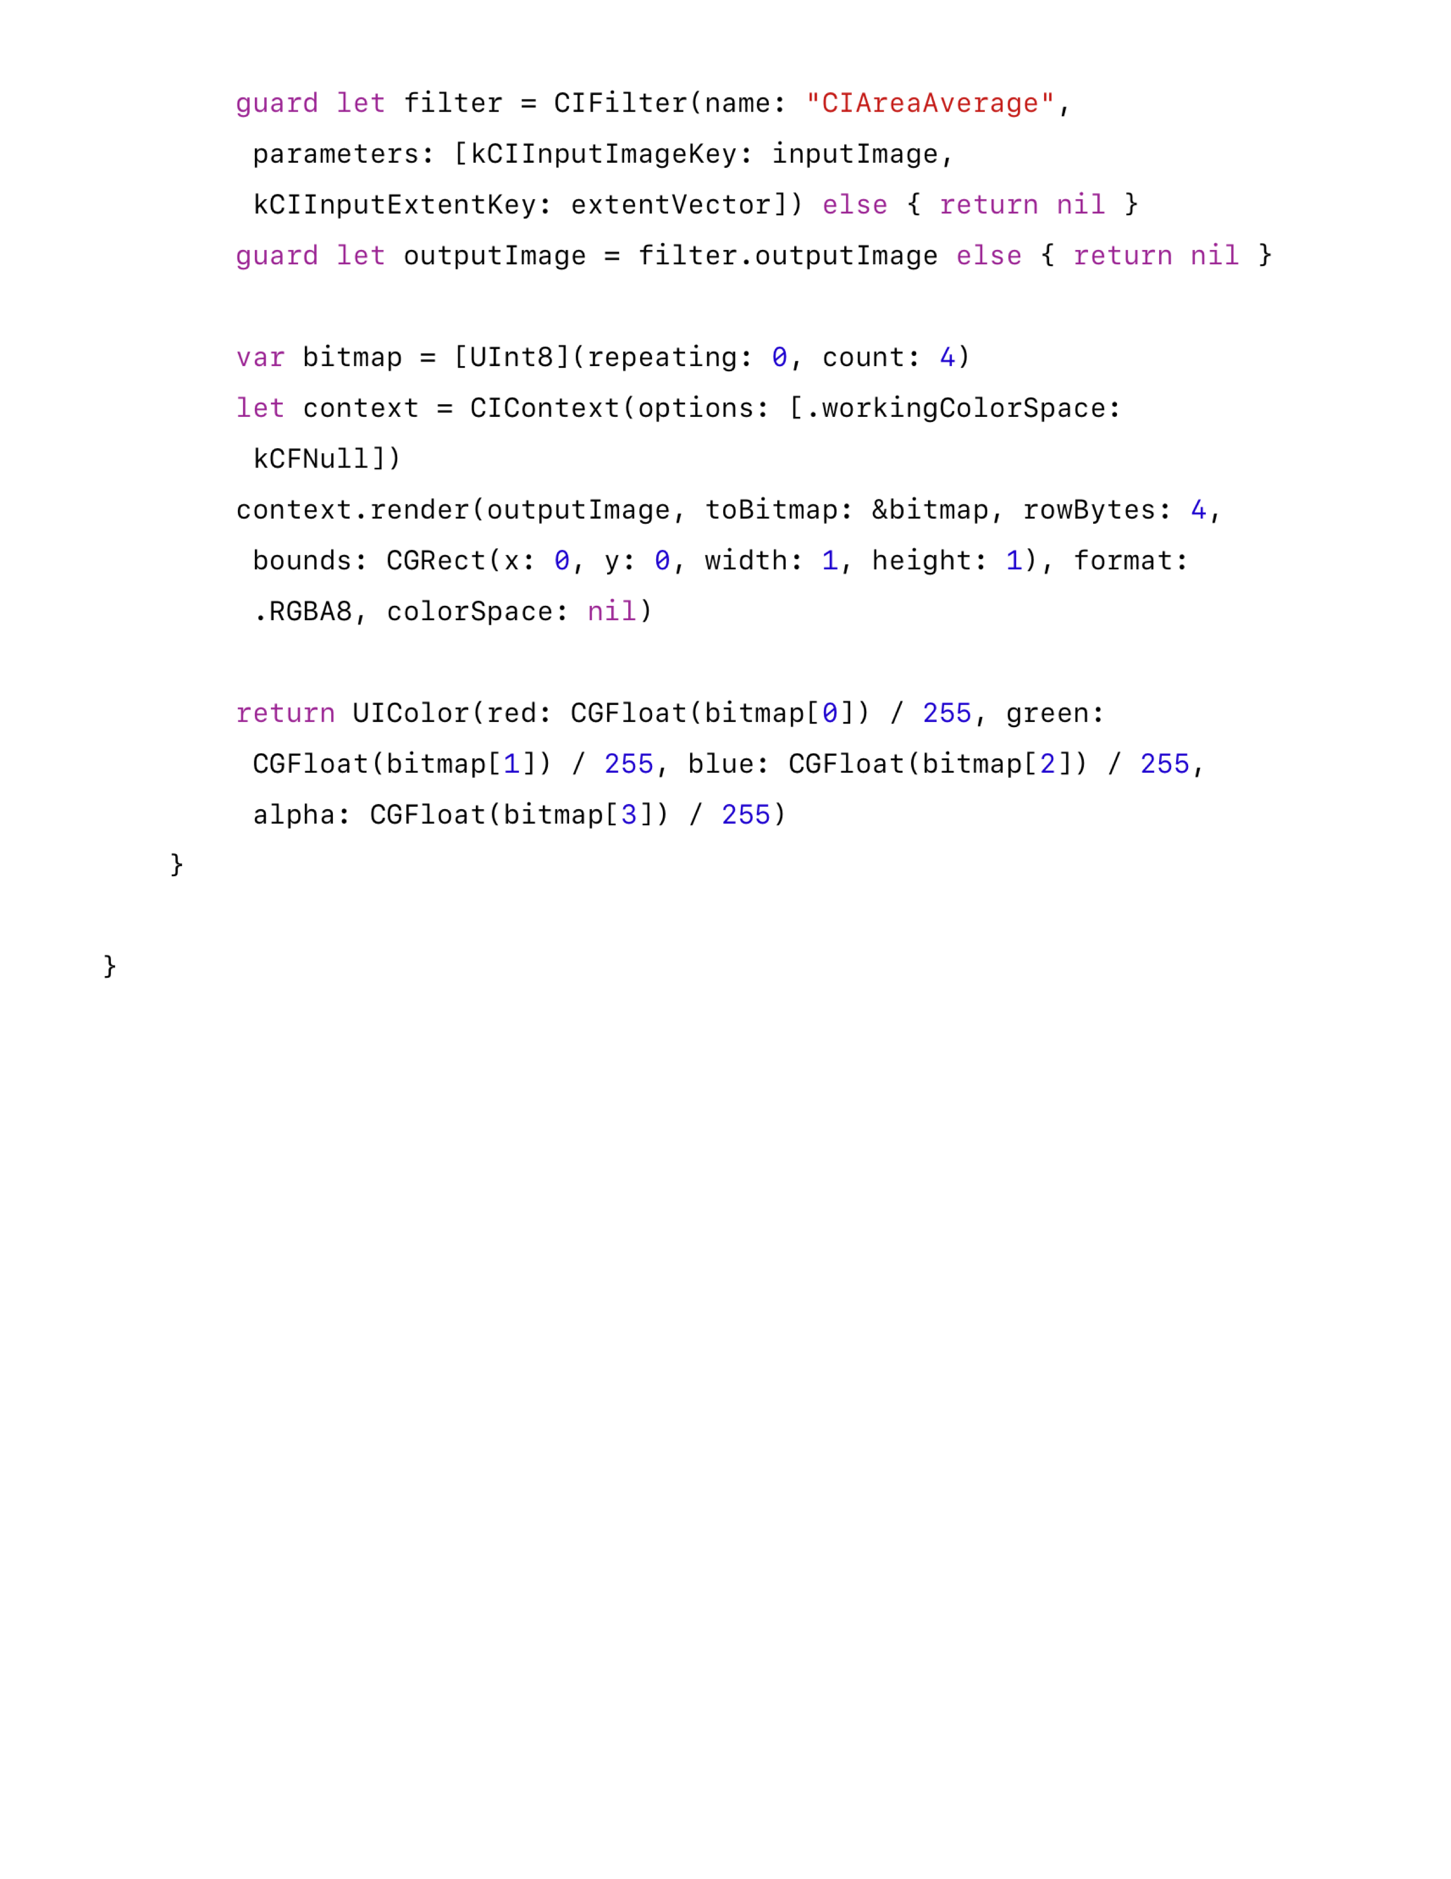
Notes:
Color UIImage extension Swift code.
In case swift playgrounds breaks on stage. Also available for the print out.
CIAreaImage - Returns a single-pixel image that contains the average color for the region of interest.

Slide 28
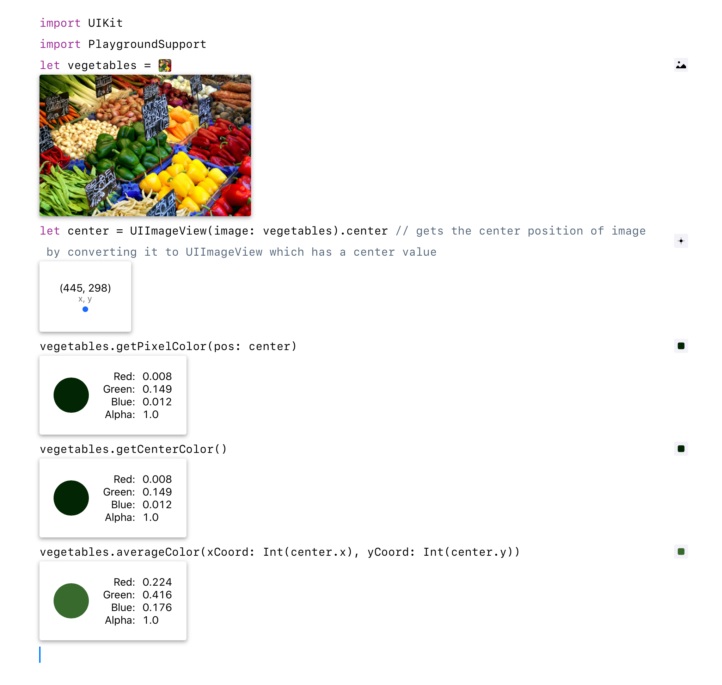

Slide 29
Still in the works…

Slide 30
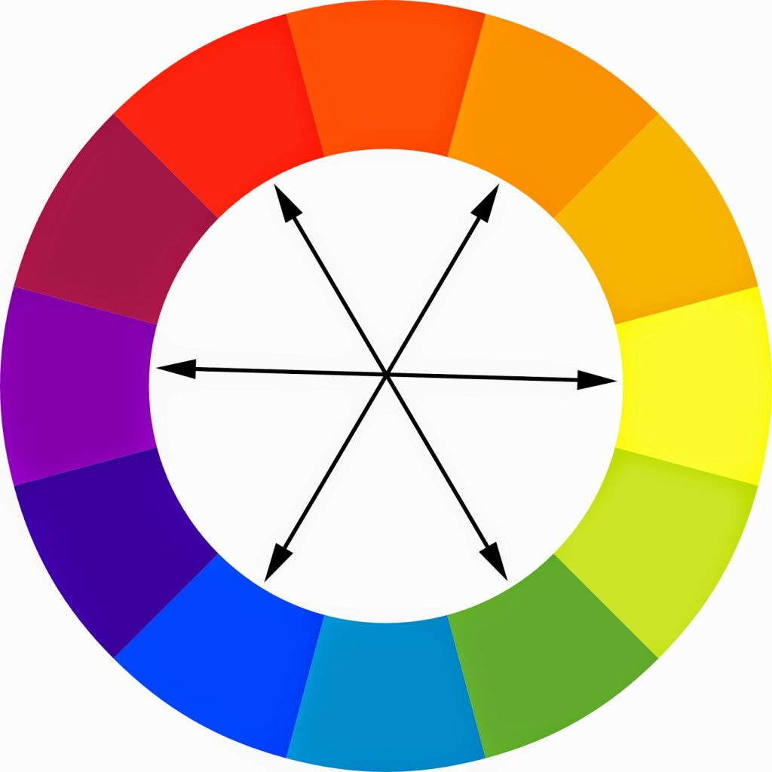
Wardrobe assistant

Slide 32
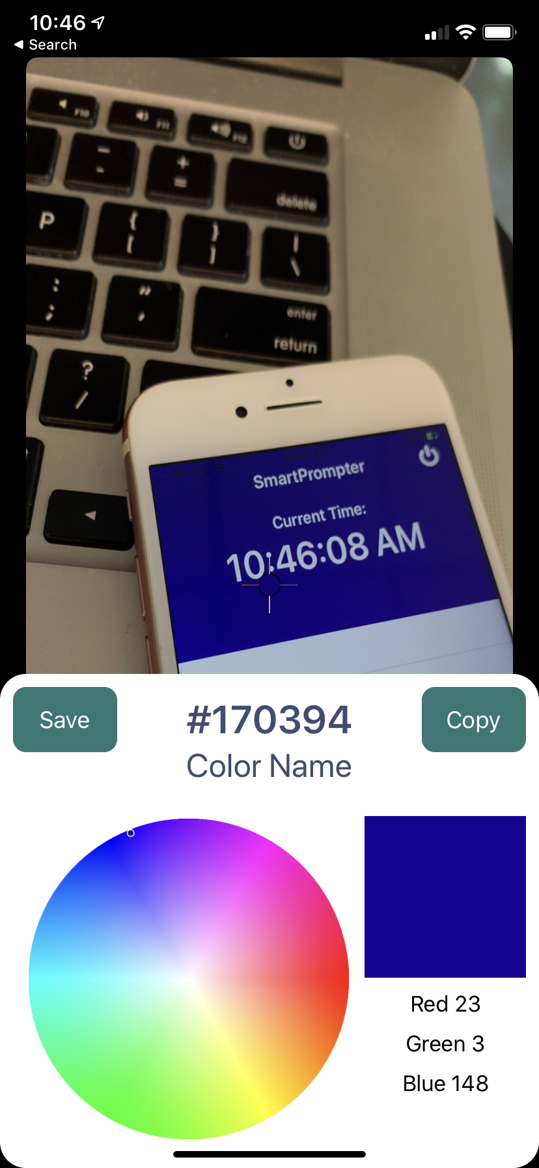
IMPROVED Color Naming

Slide 33


Would show “Blue”

Slide 34
TEAM
Notes:
Explain your roles!

Slide 35
Tasks and Growth- Alexander
Contribution
Research
Testing
Color Naming
Experiences & Skills Acquired
Swift
Teamwork / Peer Programming
Working with others code

Slide 36
Tasks and Growth- Leo
Contribution
Planning out the whole architecture with the team
Creating a brand new custom camera from scratch
Creating the UI/UX of the app
Experiences & Skills Acquired
Peer Programming
Knowledge Sharing
Team-Work & communication

Slide 37
Tasks and Growth- Zach
Contribution
Average color of center square of picture
converting RGB to hexcode
Color Research
Color naming
Experiences & Skills Acquired
Peer Programming
Knowledge Sharing
Swift
Team-Work & communication

Slide 38
Tasks and Growth- David
Contribution
Graphic design
Research of color theory in respect to design & fashion
Integration of JS color wheel
Experiences & Skills Acquired
Swift
Knowledge Sharing
Team-Work & communication
Design tools for digital media

Slide 39
Tasks and Growth- Ian
Contribution
App Architecture
Project Management
Automated Testing
Swift
Experiences & Skills Acquired
Problem Solving
Knowledge Sharing
Team-Work & communication

Slide 40
App icon

Slide 41
Tools
Notes:
Talk about xcode, swift playgrounds, swift package manager , github actions

Slide 42

Xcode
Notes:
Talk about xcode, swift playgrounds, swift package manager , github actions

Slide 43
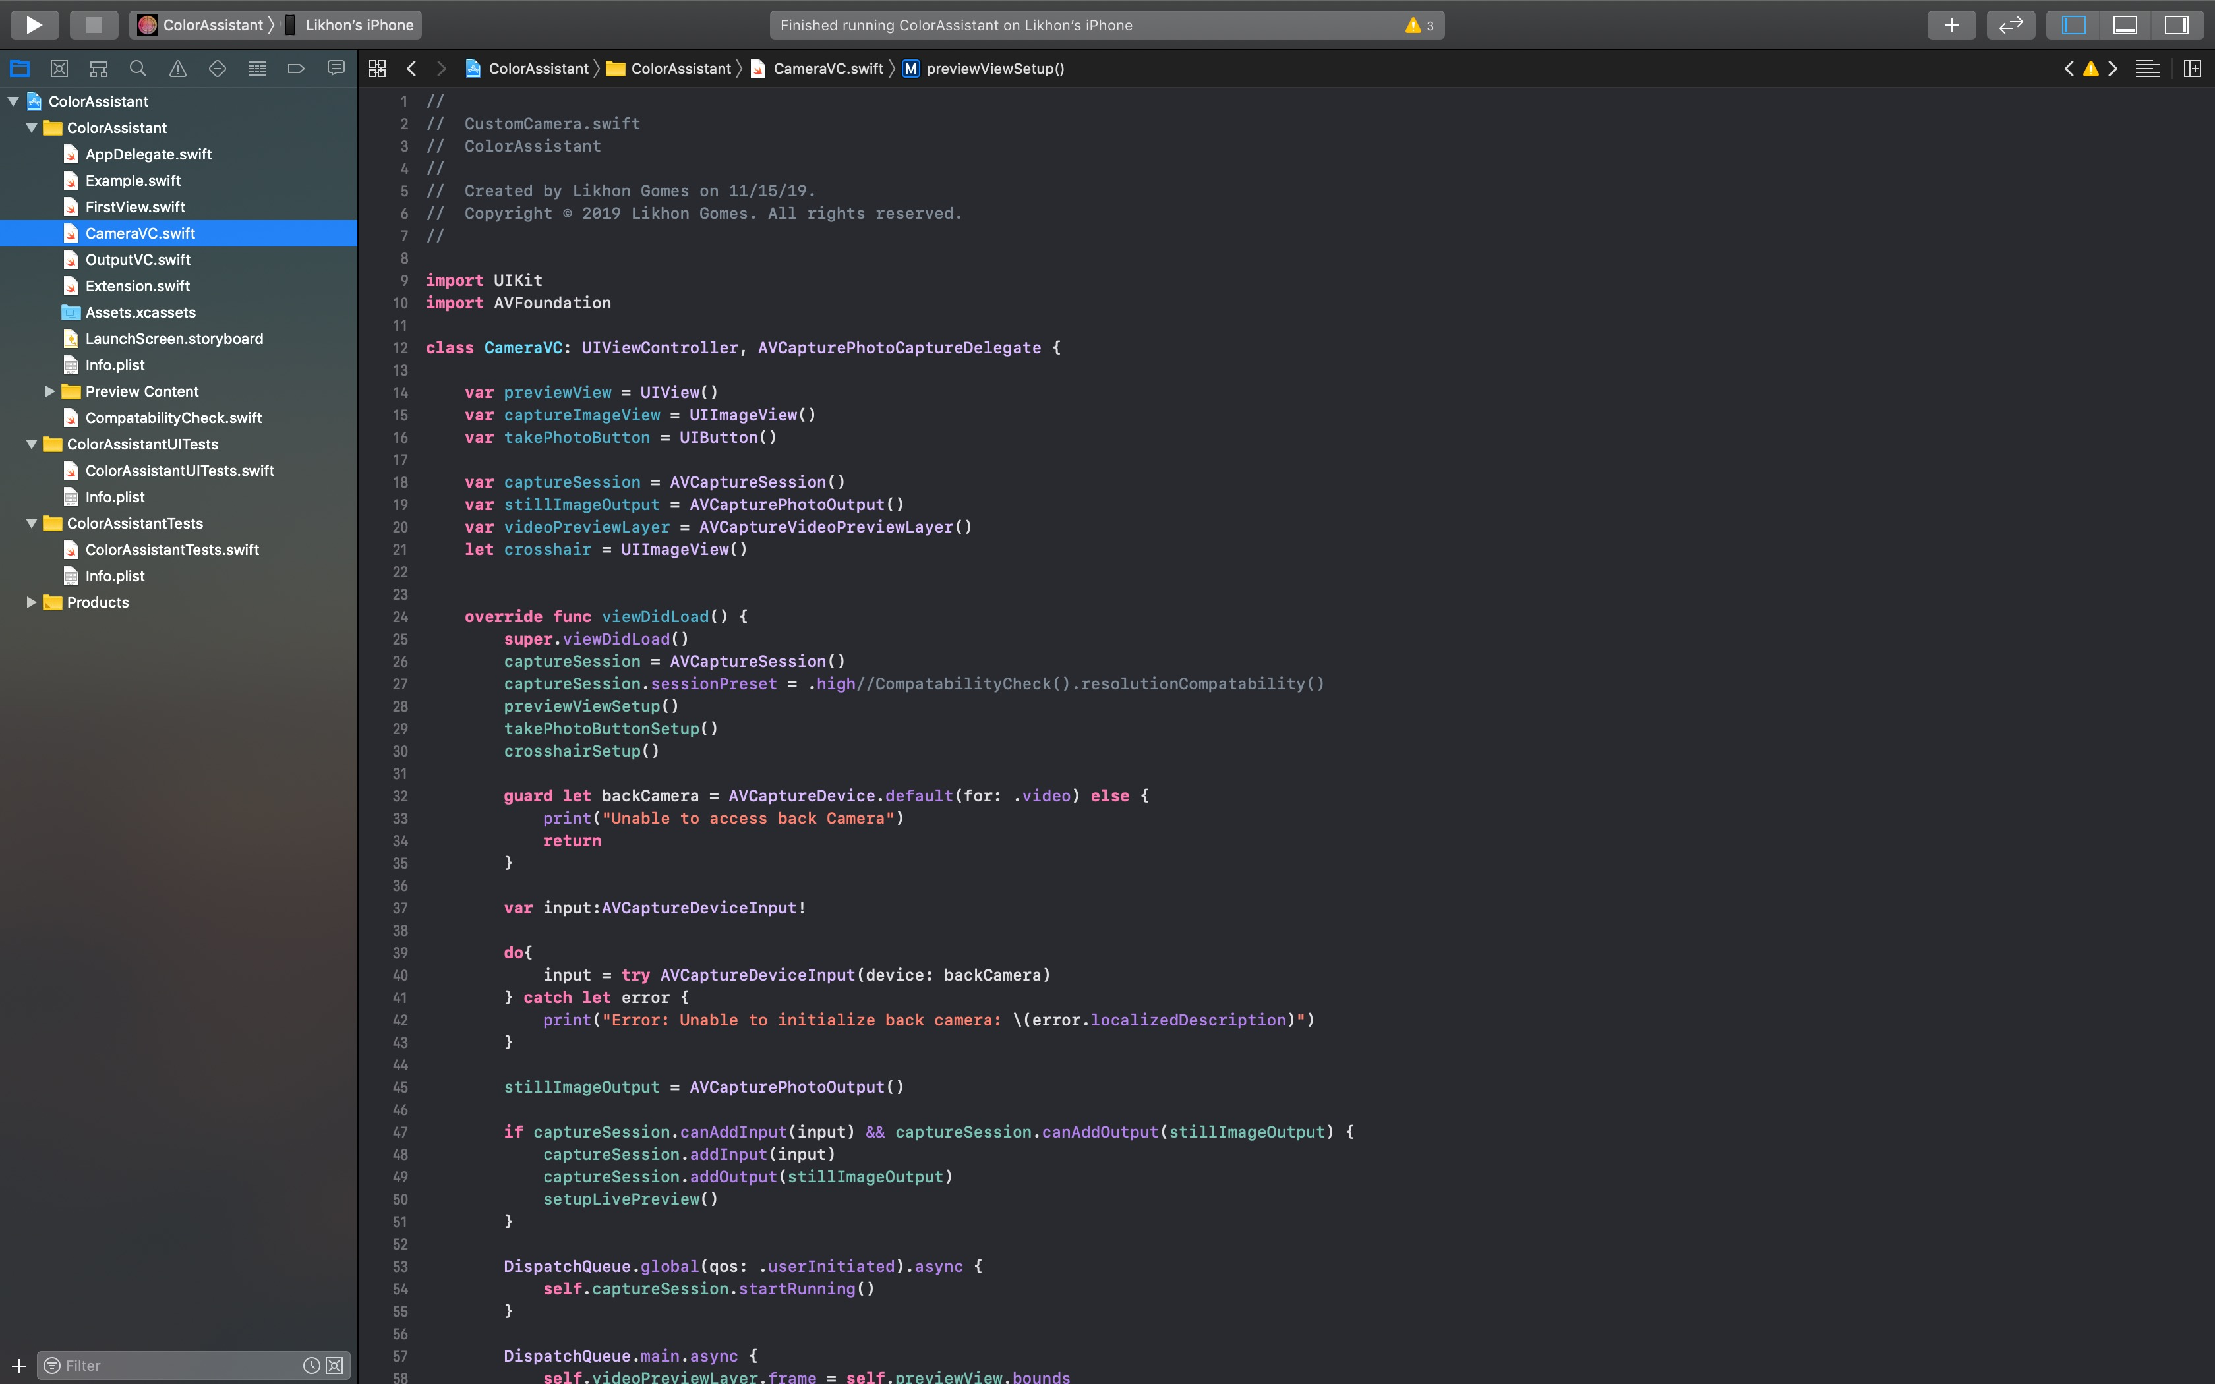
Notes:
Talk about xcode, swift playgrounds, swift package manager , github actions

Slide 44

Github Actions
Notes:
Talk about xcode, swift playgrounds, swift package manager , github actions

Slide 45
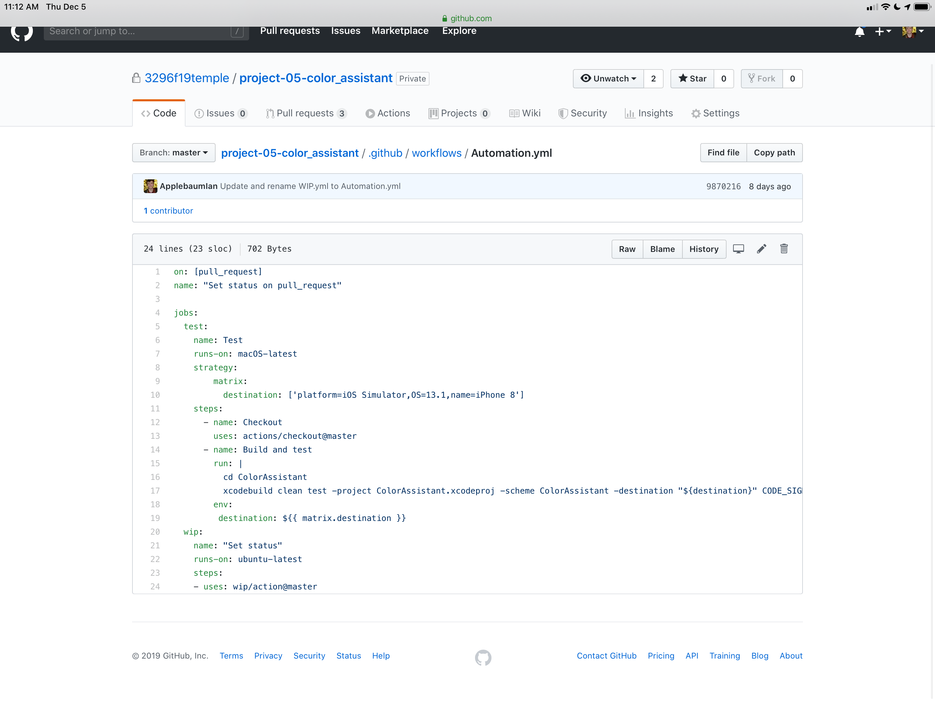
Notes:
Talk about xcode, swift playgrounds, swift package manager , github actions

Slide 46
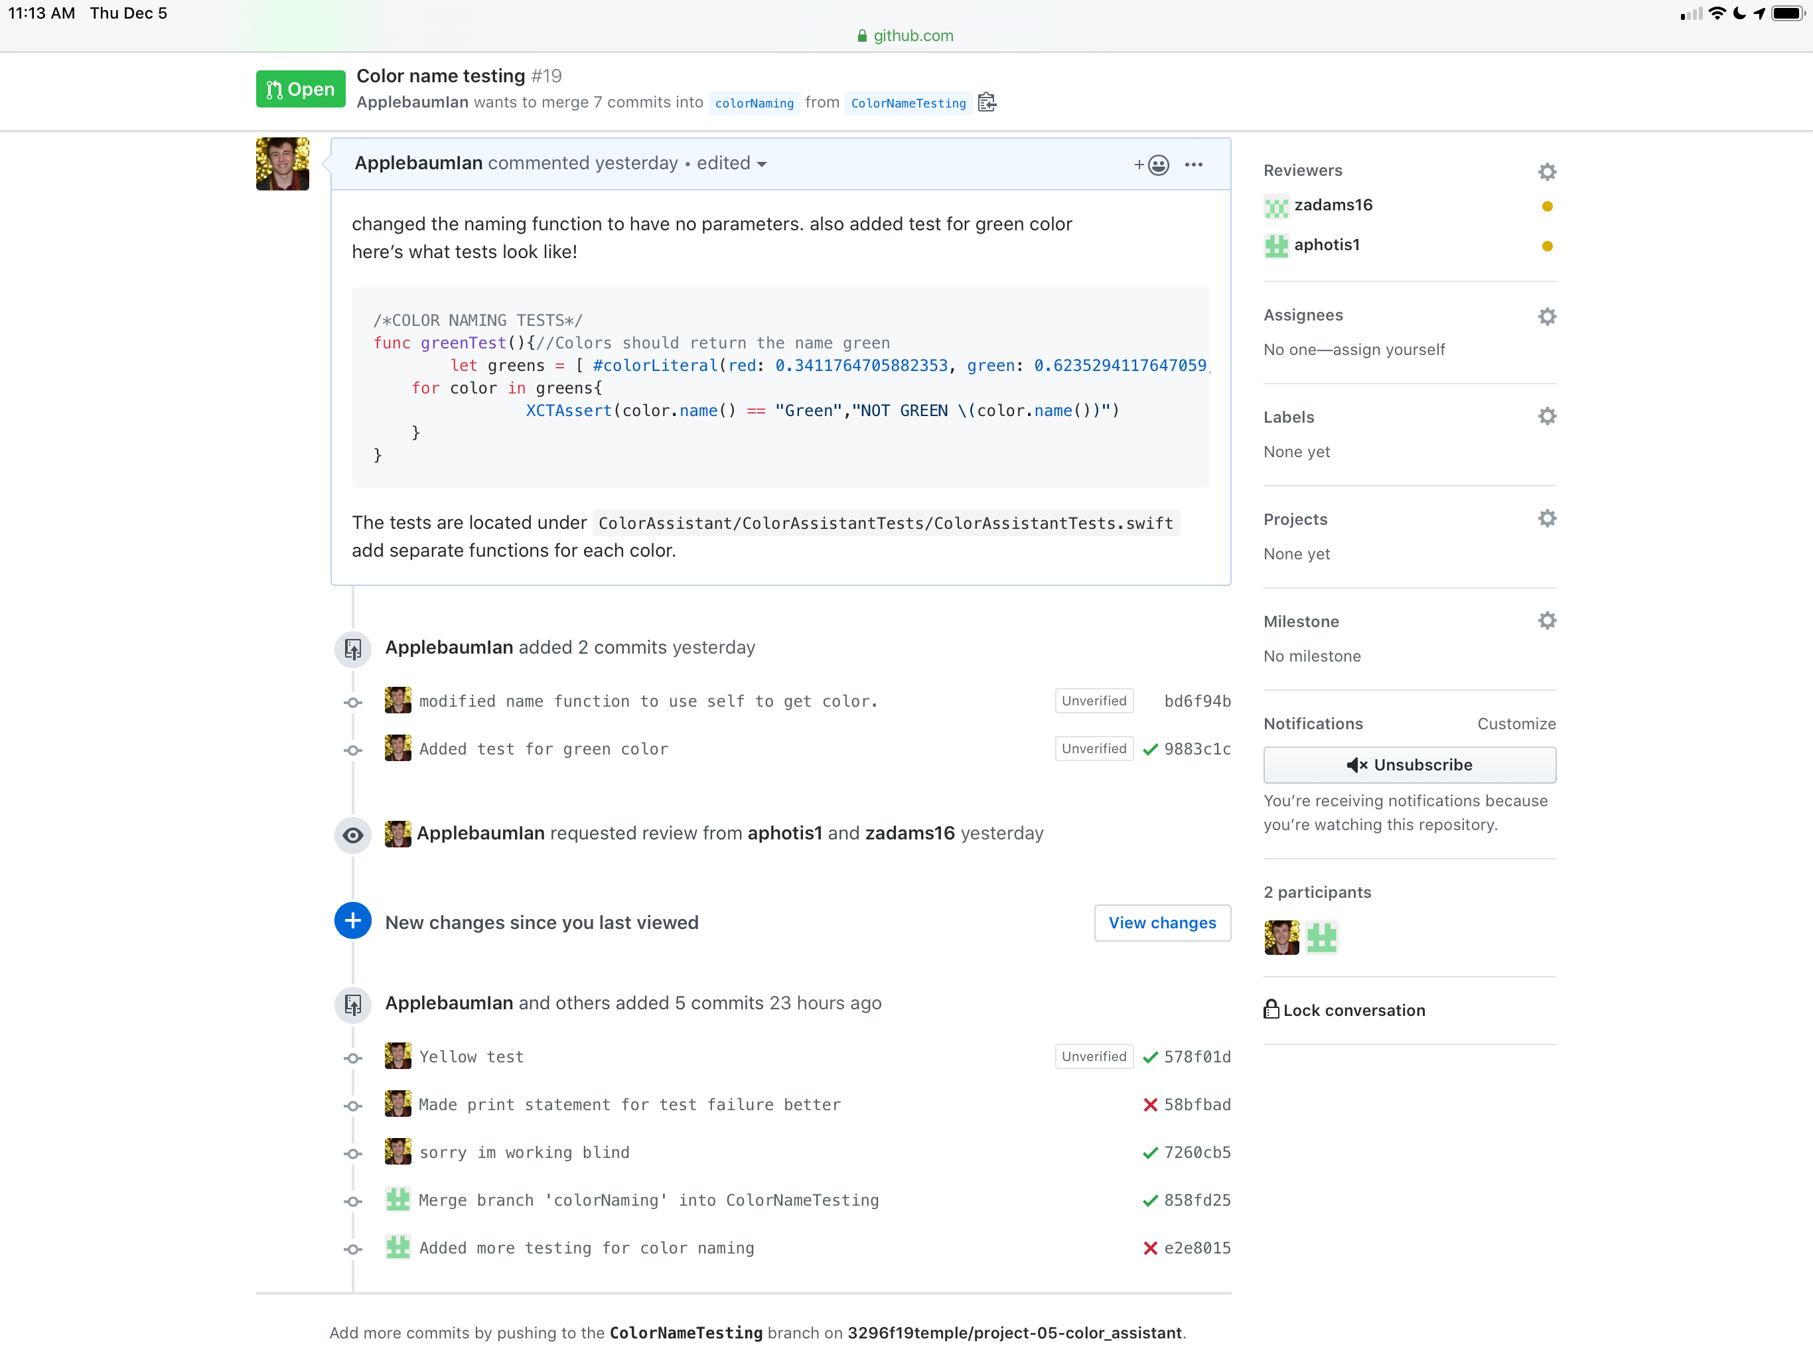
Notes:
Talk about xcode, swift playgrounds, swift package manager , github actions

Slide 47
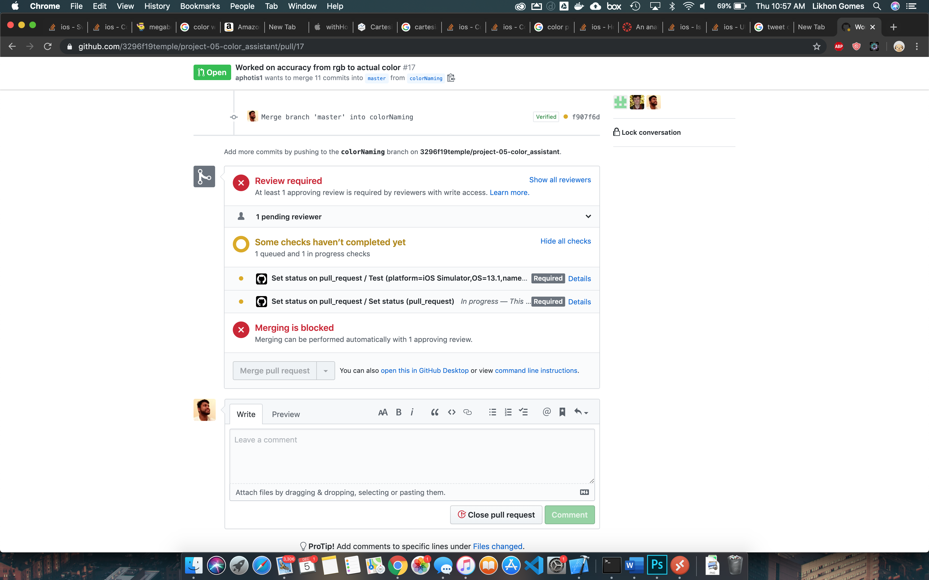
Notes:
Talk about xcode, swift playgrounds, swift package manager , github actions

Slide 48

Swift Playgrounds
Notes:
Talk about xcode, swift playgrounds, swift package manager , github actions

Slide 49
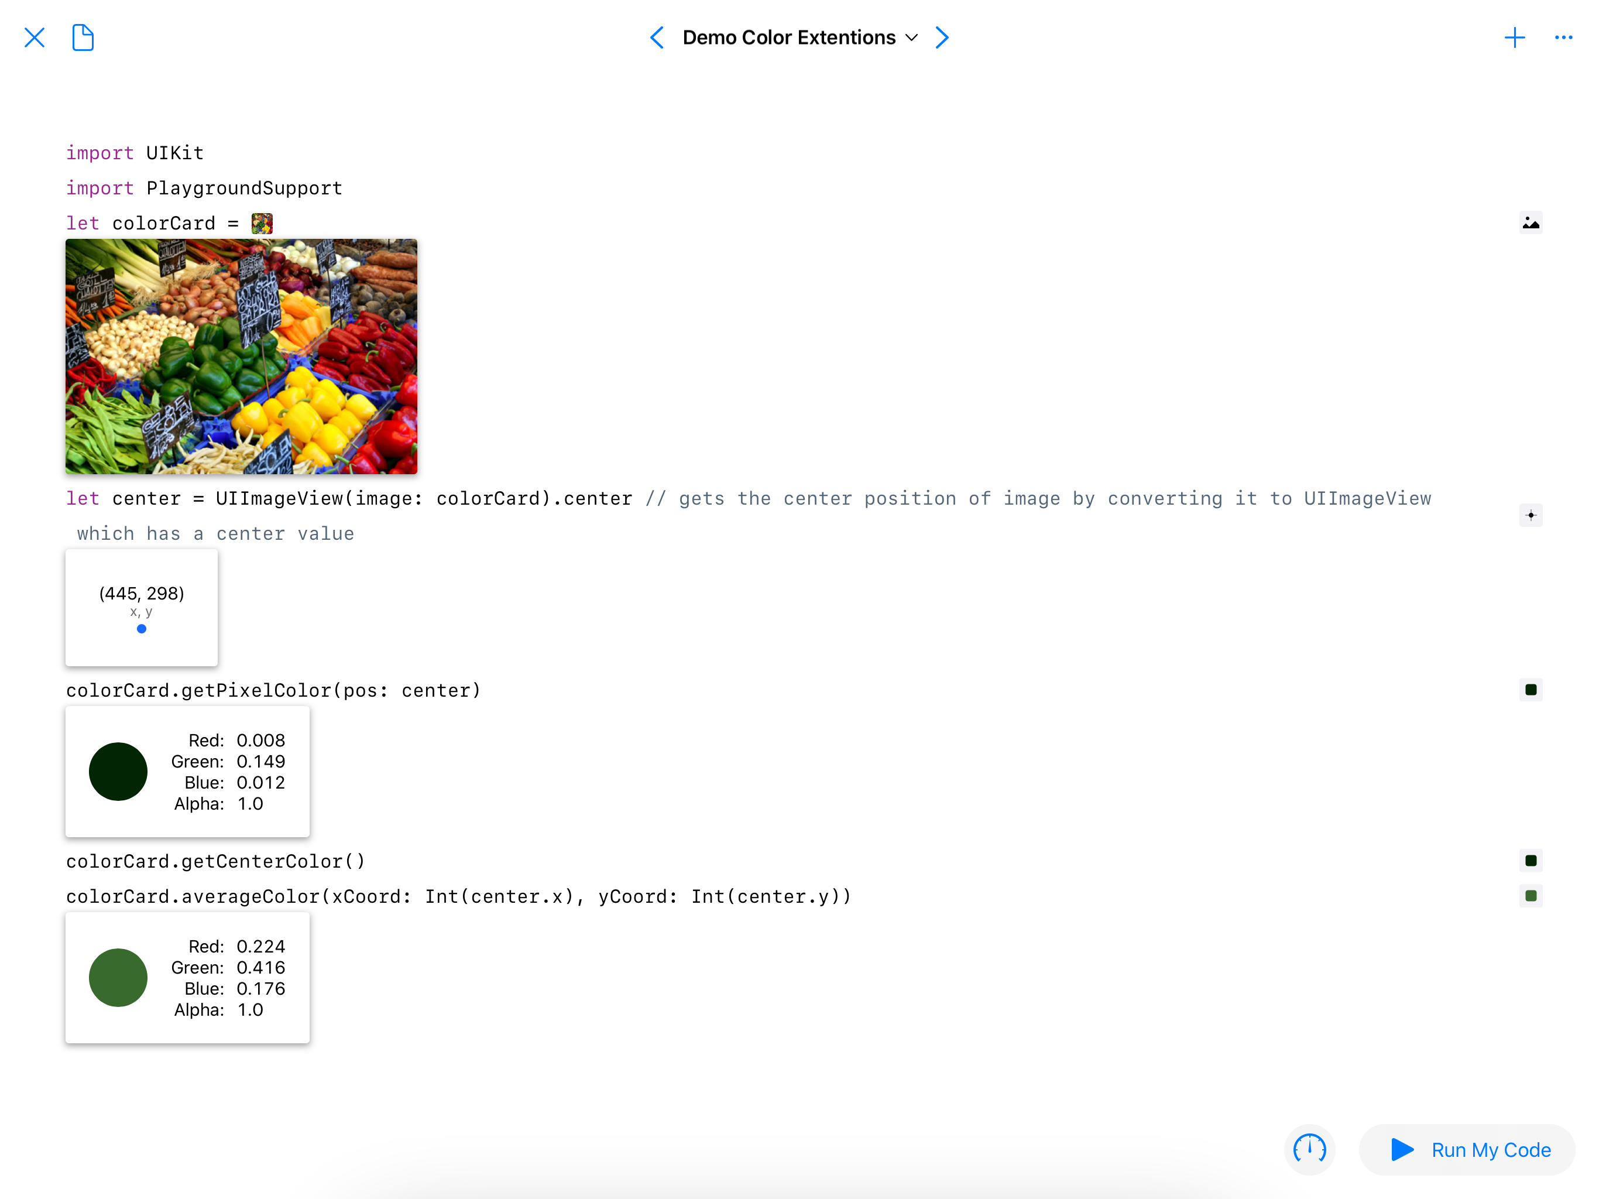
Notes:
Talk about xcode, swift playgrounds, swift package manager , github actions

Slide 50
TEAMwork
Notes:
Talk about communication how we worked together

Slide 51
Questions

